Slide 1
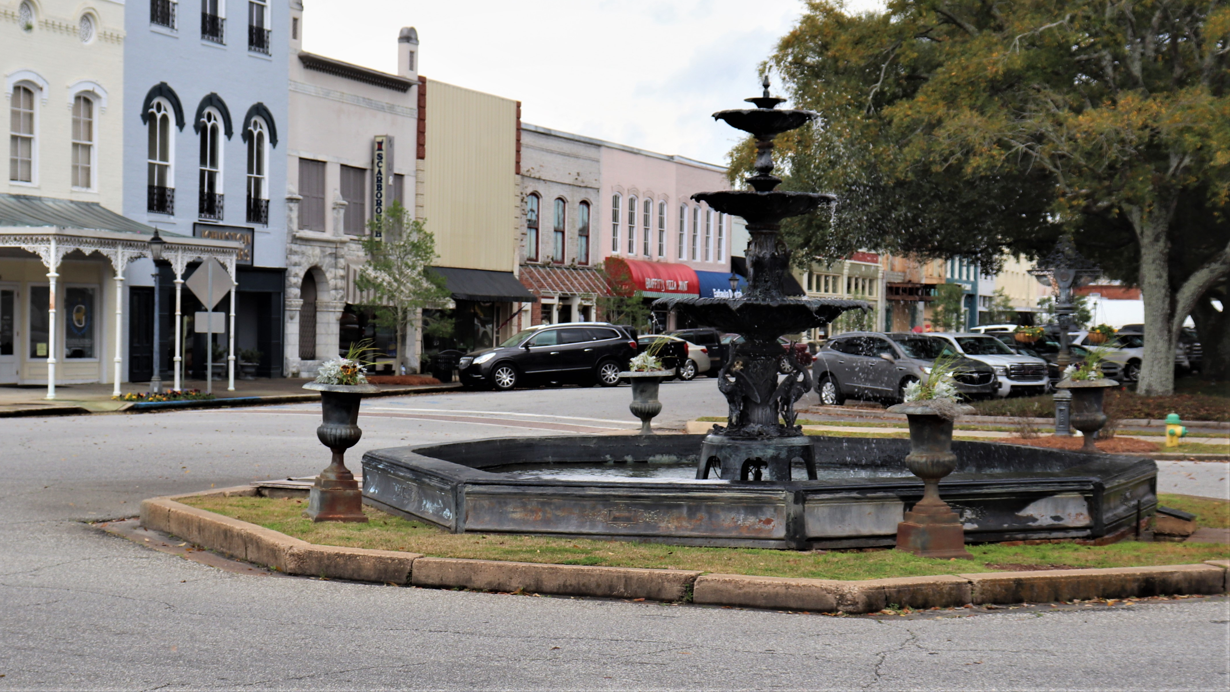
Eufaula’s Heritage, Outdoor Recreation, and Agritourism
Allie Logan, Barbour County Extension Coordinator

Slide 2
Barbour County Tidbits
Home to 6 Alabama Governors
Lake Eufaula is in Oklahoma, The lake we refer to is Lake Walter F. George and is an intracoastal waterway.
Clio is the birthplace of baseball Hall of Fame pitcher Don Sutton.
Big Bass Capitol of the World
Home of LA Rams General Manager Les Snead
Notes:
These are just a few interesting facts about Barbour County. We are home to many celebrities including singer Marilyn McCoo, fishing legend Tom Mann, superbowl winners like jeryl Jernigan and Courtney Upshaw, Katie Curric traced her ancestors back to Eufaula’s Smith Couric home on North Eufaula Ave.

Slide 3
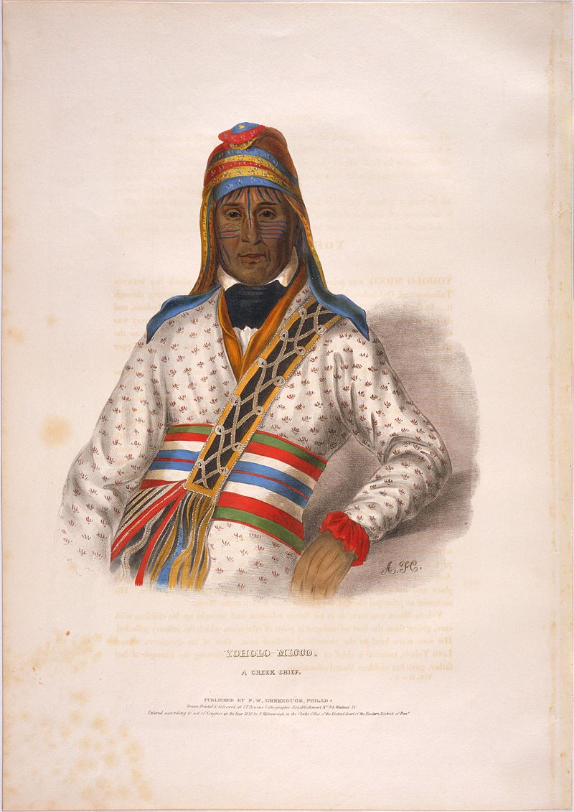
A Little History
1733
Since at least 1733, the site along the Chattahoochee River that is now Eufaula was occupied by three Creek Indian tribes of the Muscogee Nation. One of these was "the Eufaulas"
1823
In 1823, men from Georgia, looking for fertile crop land, established a permanent white settlement on these high bluffs and adopted the Creek village's name.
1832
In the Treaty of Cusseta, 1832, the Creeks ceded their land rights in the area, and Barbour County was incorporated.
1834
In 1834, Captain Seth Lore and others developed what is now the downtown area, naming the four main north-south avenues "Livingston," "Orange," "Randolph," and "Eufaula" (L-O-R-E).
Information taken from Joel Smith’s book, “A Brief History of Shorter Mansion and the Eufaula Heritage Association”, published 2007 by the Eufaula Heritage Association.
Notes:
In 1825 their chief Yoholo Micco traveled to Washington, D.C. in an attempt to renegotiate the Treaty of Indian Springs (1821).[2] They were unsuccessful, and the very disadvantageous Treaty of Indian Springs (1825) was enacted which forced them to move across the river in Eufaula, Alabama, where a bike trail commemorates their story.[3]
In 1836 they were forced further west again, during the Trail of Tears. Their people were the only Upper Creek town that moved to Indian Territory; they settled near what developed as Eufaula, Oklahoma, named for them and their towns.[1]

Slide 4
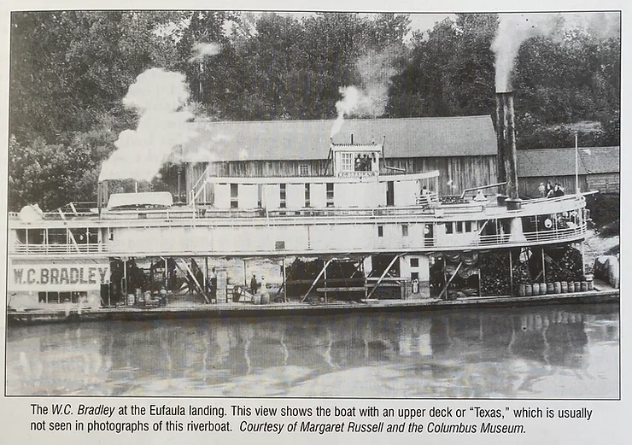
A Little History
1843
1865
1880s
1963-64
1966
The town was renamed "Eufaula," because mail was constantly being misdirected to Irwinton, Georgia.
Eufaula was booming again with cotton mills, steamboats, and railways
The Army Corps of Engineers' creation of Lake Walter F. George. 11,184-acre Eufaula National Wildlife Refuge was purchased.
The first Eufaula Pilgrimage was held April 11 – 17. Fishing Tournaments and Tom Mann’s Bait Company put Eufaula on the map.
April 29, a messenger galloped in with news that the Union was approaching. The mayor and citizens met the soldiers at College Hill with the news, the war was over. Eufaula remained intact, her people unharmed.
Information taken from Joel Smith’s book, “A Brief History of Shorter Mansion and the Eufaula Heritage Association”, published 2007 by the Eufaula Heritage Association.

Slide 5
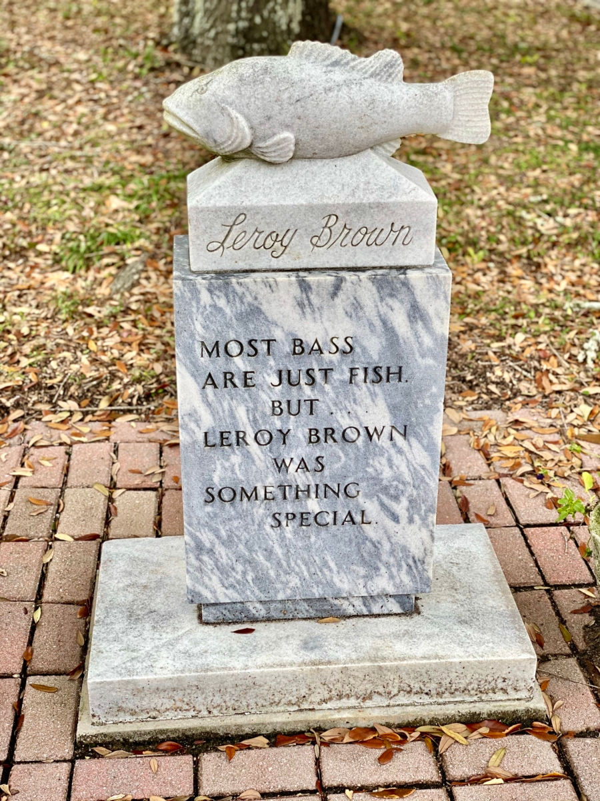
A Little History
1968
Lakepoint State Park was founded.
2004
2020
Main Street Eufaula Founded
Splash Pad Park and downtown renovation of the Martin Theater
2018
Manny the Bass
1985
The Jackson Five visit relatives in Barbour County.
Death of Leroy Brown
1980
Information taken from Joel Smith’s book, “A Brief History of Shorter Mansion and the Eufaula Heritage Association”, published 2007 by the Eufaula Heritage Association.
Notes:
he Mann family named their pet after Jim Croce’s popular 1970s song, “Bad, Bad, Leroy Brown.” The name fit and word spread. Eufaula was seized by fish fame.
People came from everywhere to behold the bass. He received fan mail from around the world. Leroy made the front page of The Atlanta Constitution. He was featured in Southern Living magazine and in news stories as far away as Africa and Australia.
In August 1980, Tom Mann discovered his prized pet floating. Silence had seized the fish that roared. Leroy Brown died of natural causes.
Tom’s close friend Ray Scott, founder of the Bass Anglers Sportsman Society (B.A.S.S), was consulted. They agreed that Leroy deserved a funeral. Approximately $4,000 was spent on a customized headstone. A casket was made from a satin-lined tackle box complete with strawberry jelly worms to accommodate Leroy in the hereafter.
At Lakepoint Lodge, about 800 people attended the funeral for a big mouth bass. Pallbearers included Roland Martin and other fishing celebrities. The Eufaula High School Marching Band played “Bad, Bad Leroy Brown” and Alabama Gov. Fob James declared a Day of Mourning for the fallen fish.
But at nightfall, something fishy happened. Leroy’s casket was not buried the day of the funeral because of intense rain making the gravesite too wet. The casket was stored in a freezer. Thieves in the night stole the body and left a ransom note: 1 million jelly worms for Leroy’s return.
Eufaula Elementary School fifth-grader Mackenzie Young, dressed as the legendary largemouth bass, portrays Leroy Brown during Eufaula’s Pilgrimage Celebration in April. She is the 11-year-old daughter of Scott and Lauran Young of Abbeville.
(Courtesy of Lauran Young)
Weeks later the remains were found at the Tulsa, Oklahoma, airport’s lost baggage department. The fish carcass was never returned to Eufaula nor the grave-robbers ever found.
For years, Leroy’s monument lay idle, to be discovered by Tibbs. “I was fishing at Ray Scott’s fishing lodge in Pintlala and saw it on the property,” Tibbs said. “I thought, ‘Wow, that’s Leroy Brown!’”
Tibbs met with Dixon to ask Ray Scott’s permission to return the stone to Eufaula. Scott agreed.

Slide 6
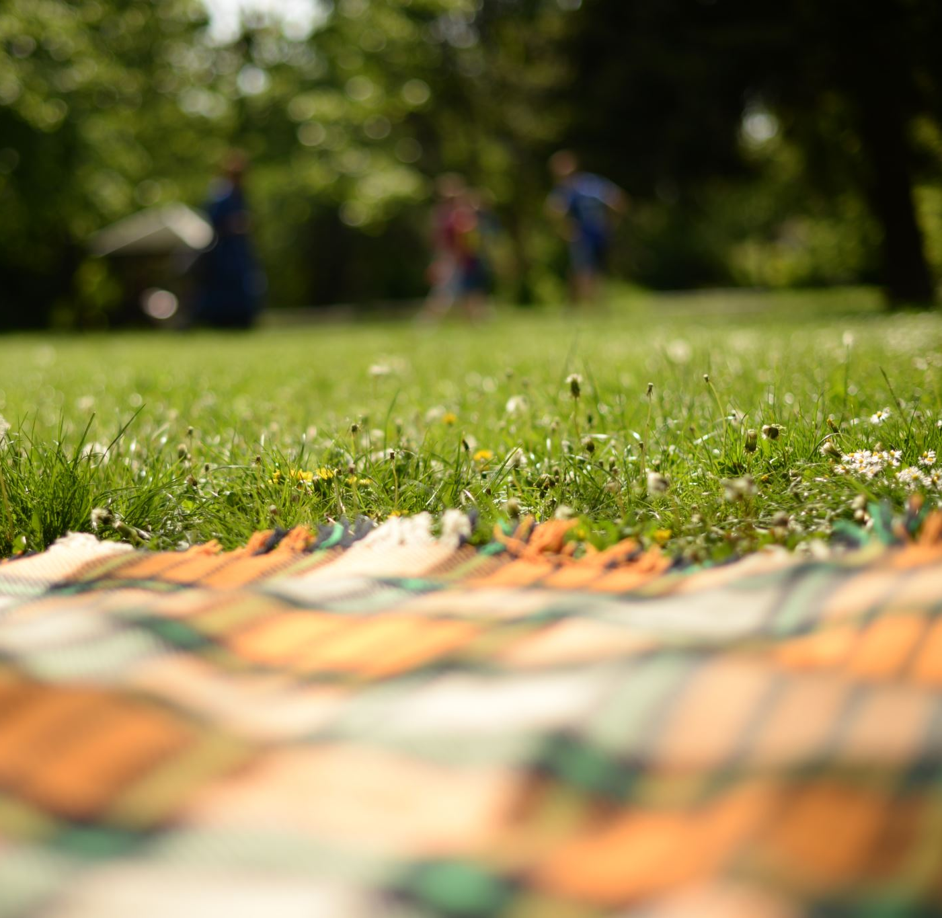
Outdoor Recreation

Slide 7
Outdoor Activities
Kayaking
Hiking
Fishing
Hunting
Boating
Horse Back Riding
Birding
Camping

Slide 8
Tourism by the Numbers
2012 Corps of Engineers estimated 2.6 million visitors to the lake.
Historic tourism and recreation averages 16,000 people a year.
2020 Alabama had 56,000 jobs in outdoor recreation and accounted for $4.2 billion value-added dollars to the economy. (Bureau of Economic Analysis)
Wehle Center hosted 1,136 visitors in 2021 (Foreverwild 2021 Annual Report)

Slide 9
Places to Visit
Wehle Nature Center
Wildlife Refuge

Slide 10
Places to Visit
Lakepoint State Park
White Oak

Slide 11
Places to Visit
Blue Springs State Park
Old Creek town Park

Slide 12
Area Places to Visit
Providence Canyon (GA)
Florence Marina State Park (GA)

Slide 13
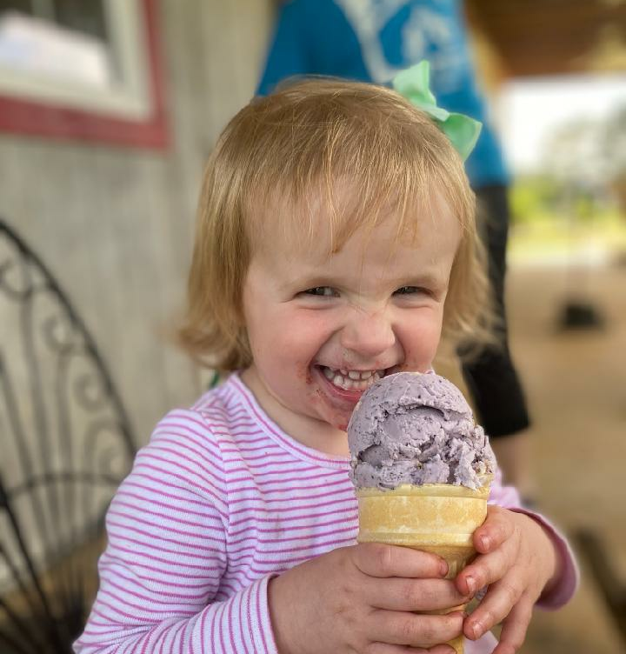
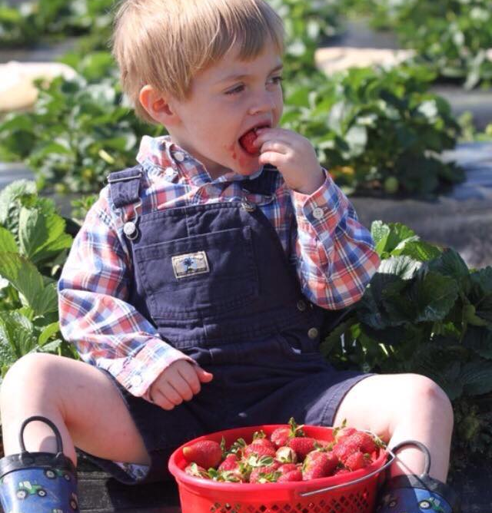
Agritourism

Slide 14
What is Agritourism?
•Definitions of agritourism are as unique as the farm and outdoor recreation operations hosting these activities
•In general, “agritourism is any activity that generates supplemental income for working farms and ranches by connecting their resources and products with visitors”
•Agritourism showcases a region’s unique landscape, flavors, and culture
•Supported by the rise of the local food and farm-to-table movements, agritourism gives farm operators a powerful way to connect with communities and out-of-town visitors
Hall, Ulmer, Logan 2020
Notes:
Supplemental income for farm and ranches. If not making the income it may not be agritourism

Slide 15
Game Time

Slide 16
Join Game @ www.kahoot.it 1. Enter Pin 2. Enter Name

Slide 17
5 Categories of Agritourism Activities
Education
Direct sales
Hospitality
Outdoor recreation
Entertainment

Slide 18
Education
Farm tours
Classes
Tastings
Field Trips

Slide 19
Direct Sales
U-Pick
U-Cut
On-farm produce stands
Fishing Ponds

Slide 20
Hospitality
Events invite guests for farm-to-table dinners
Overnight farm stays

Slide 21
Outdoor Recreation
Fishing
Hunting
Horseback riding
Mountain biking

Slide 22
Entertainment
Corn Mazes
Pumpkin Patches
Weddings
Concert Venues

Slide 23
Historical Context of Agritourism
Though agritourism has experienced a surge of popularity in the past couple decades, visiting farms is not a new trend
During the industrial age, visits to farms helped families escape the bustle of city life
In the midst of the Great Depression and World War II, families sought to visit rural areas to find tranquility
As generations of families became continually separated from farm life, horseback riding and farm petting zoos reflected farm nostalgia during the 1960s and 1970s
Farm vacations, bed and breakfasts, and commercial farm tours have been agritourism mainstays since the 1980s and 1990s
Hall, Ulmer, Logan 2020

Slide 24
Reasons to consider agritourism
Earnings potential
Agritourism can increase awareness of your farm and the products you produce
Building Community & Quality of Place
Encouraging tourists to engage with your farm through agritourism related ventures creates activities to drive economic activity in your community
Hall, Ulmer, Logan 2020
Notes:
Diversifying your farm with agritourism can provide a second or third line of revenue stream that can help offset losses in low production years.

Slide 25
Allie Logan
Barbour County Extension Coordinator
corcoja@auburn.edu
334-402-1347
334-687-5688

